Slide 1
Chapter 3 Considering the Use of Algorithms
Discovering the role of algorithms in AI
Winning games with state-space search and min-max
Analyzing how expert systems work
Seeing that machine learning and deep learning are part of AI

Slide 2
This chapter helps you understand the relationship between algorithms and the data used to make them perform useful work.
No matter how much data you have, you still need an algorithm to make it useful.
You must perform data analysis (a series of definable steps), to make data work correctly with the chosen algorithms.
Machines that learn by themselves are in the distant future.
The second half of this chapter helps you understand the role of expert systems, machine learning, deep learning, and applications.

Slide 3
Understanding the Role of Algorithms
An algorithm is a procedure that consists of a sequence of operations.
Usually, a computer deals with these operations by either finding the correct solution to a problem in a finite time or telling you that no solution exists.
People have solved algorithms manually for literally thousands of years.
Algorithms are all about finding solutions, and the speedier and easier, the better.

Slide 4
Understanding what algorithm means
The scope of algorithms is incredibly large.
You can find algorithms that solve problems in science, medicine, finance, industrial production and supply, and communication.
All algorithms contain sequences of operations to find the correct solution to a problem in a reasonable time (or report back if no solution is found).
A subclass of algorithms, heuristics, produce good, but not necessarily perfect, solutions when time is more critical than finding the perfect solution.

Slide 5
AI algorithms tend to deal with complex problems, which are often part of the NP-complete class of problems (where NP is nondeterministic polynomial time) that humans routinely deal with by using a mix of rational approach and intuition.
Here are just a few examples:
  Scheduling problems and allocating scarce resources
  Searching routes in complex physical or figurative spaces
  Recognizing patterns in image vision (versus something like image restoration nor image processing) or sound perception
  Processing language (both text understanding and language translation)
  Playing (and winning) competitive games

Slide 6
Planning and branching: Trees and nodes
Planning helps you determine the sequence of actions to perform to achieve a certain goal.
Starting from the present state, an AI determines all the possible actions from that state first.
Technically, it expands the current state into a number of future states.
When you can’t expand the states anymore and the AI stops the expansion, the AI has created a state space, which is composed of whatever could happen in the future.
AI can use that state space to explore decisions it can make to reach its goal in the best way. This process is known as the state-space search.

Slide 7
Working with a state space requires use of both particular data structures and algorithms.
The core data structures commonly used are trees and graphs.
The favored algorithms used to efficiently explore graphs include breadth-first search or depth-first search.

Slide 8
Building a tree works in much the same way that a tree grows in the physical world.
Each item you add to the tree is a node. Nodes connect to each other using links.
The root node is the starting point for the processing you perform.
A leaf node is an ending point for the tree. Branch nodes support either other branches or leaves.

Slide 9
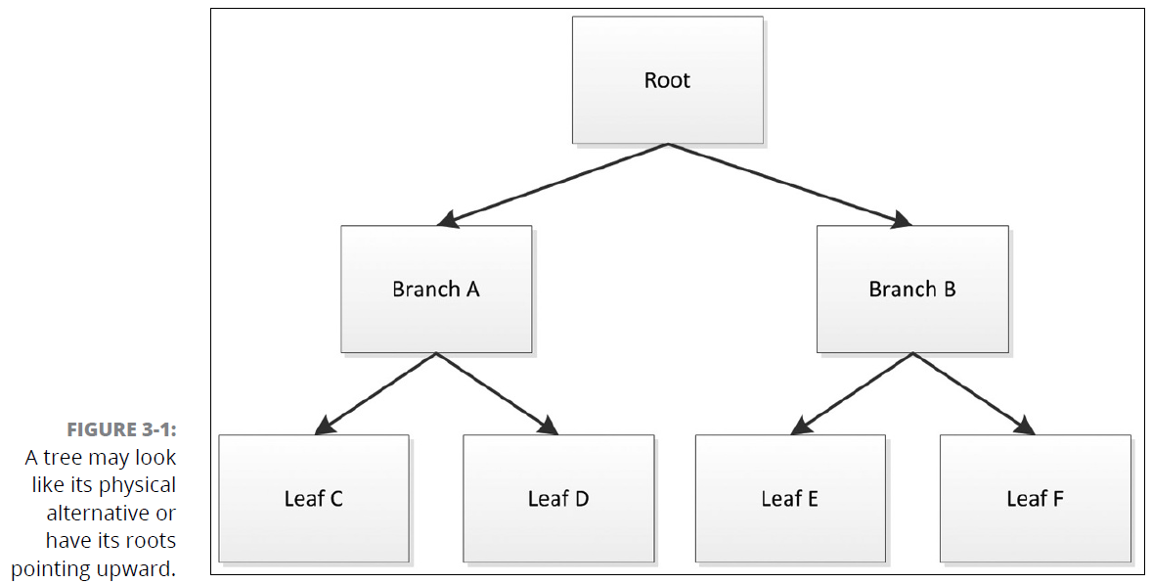

Slide 10
Extending the tree using graph nodes
Graphs are structures that present a number of nodes (or vertexes) connected by a number of edges or arcs (depending on the representation).
A graph node can connect to any other node with a specific direction in mind.
A graph can designate a weight to a particular connection. The weight could define the distance between two points, define the time required to traverse the route, specify the amount of fuel used to travel the route, or provide other sorts of information.

Slide 11
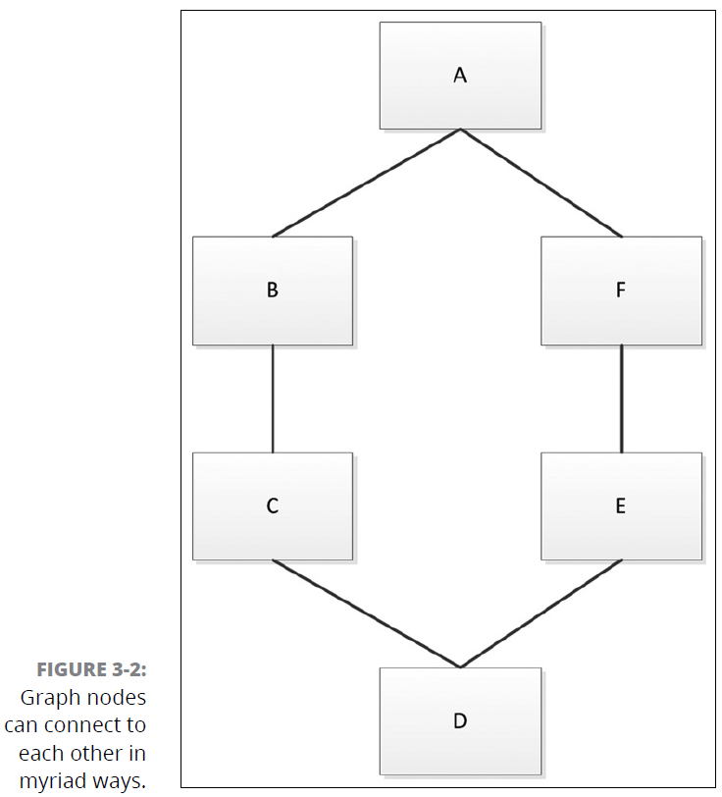

Slide 12
Traversing the graph
Traversing a graph means to search (visit) each vertex (node) in a specific order.
  Uninformed (blind search)
    Breadth-first search (BFS)
    Depth-first search (DFS)
  Informed (heuristic)
    Best-first search
    Greedy search
    A* search

Slide 13
Playing adversarial games
The interesting thing about state-space search is that it represents both AI’s current functionality and future opportunities.
This is the case with adversarial games.
A simple game like tic-tac-toe presents a perfect example of a space search game that you may already have seen an AI play.

Slide 14
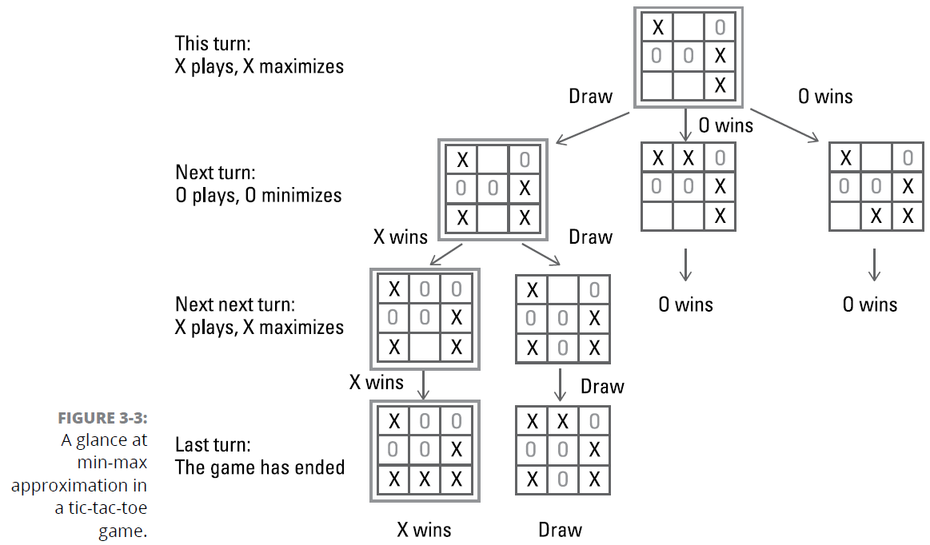

Slide 15
Using local search and heuristics
No machine, no matter how powerful, can enumerate all the possibilities that spring from a complex situation.
Optimization using local search and heuristics helps by using constraints to limit the beginning number of possible evaluations.
Local search is a general problem-solving approach that comprises a large range of algorithms that help you escape the exponential complexities of many NP problems.
Local search algorithms iteratively improve from a starting state, moving one step at a time through neighboring solutions in the state space until they can’t improve the solution any further.

Slide 16
Start with an existing situation (it could be the present situation or a random or known solution).
Search for a set of possible new solutions within the current solution’s neighborhood, which constitutes the candidates’ list.
Determine which solution to use in place of the current solution based on the output of a heuristic that accepts the candidates’ list as input.
Continue performing Steps 2 and 3 until you see no further solution improvement, which means that you have the best solution available.

Slide 17
A local search can rely on more reasoned exploration solutions using well-devised heuristics to get directions:
  Hill climbing
  Twiddle (coordinate descent algorithms)
  Simulated annealing
  Taboo search

Slide 18
Discovering the Learning Machine
They require an architect who studies the problem and chooses the right algorithm to solve it.
Real-life problems are never set in simple worlds of perfect information and well-defined action.
  A large set of rules and possibilities
  Missing information
  Problem rules aren't immutable
To solve such problems, you can’t use a predetermined approach, but rather need a flexible approach and must accumulate useful knowledge to face any new challenge.
You continue learning, as humans do throughout their lives to cope with a changing and challenging environment.

Slide 19
Leveraging expert systems
Expert systems, a system of using rules to make decisions, were the first attempt to escape the realm of hard-coded algorithms and create more flexible and smart ways to solve real-life problems.
Expert systems were experts not because they based their knowledge on their own learning process, but rather because they collected it from human experts.

Slide 20
MYCIN: A beginning expert system
MYCIN: A system, written in LISP, to diagnose blood-clotting diseases or infections caused by bacteria.
MYCIN recommended the right dosage of antibiotics by using well over 500 rules, and it relied, when needed, on the doctor using the system.
MYCIN performed better than any junior doctor, reaching the elevated diagnosis accuracy of an experienced doctor.

Slide 21
The components of expert systems
The knowledge base retains knowledge as a collection of rules in the form of if-then statements (with if involving one or multiple conditions and then involving conclusion statements).
Boolean logic or sophisticated first-order logic.
The inference engine is a set of instructions that tell the system how to manipulate the conditions based on Boolean logic set of operators such as AND, OR, NOT.

Slide 22
When dealing with the inference engine, common operations by the expert systems were as follows:
  Forward chaining
  Backward chaining
  Conflict resolution
One great advantage of such systems was to represent knowledge in a human readable form, rendering the decision-making process transparent.
If the system reaches a conclusion, it returns the rules used to reach that conclusion.

Slide 23
Introducing machine learning
Machine learning deals with problems that humans don’t know how to detail into steps, but that humans naturally solve, such as recognizing faces in images or certain words in a spoken discussion.
Show the system examples, rather specify detailed procedure.

Slide 24
Touching new heights
The role of machine learning in the new wave of AI algorithms is to in part replace, in part supplement, existing algorithms.
Machine learning works with activities that require intelligence from a human point of view but that aren’t easy to formalize as a precise sequence of steps.

Slide 25
Google’s DeepMind team in London developed AlphaGo, a program that has defeated a number of top-ranked Go players.
  A smart-search method based on random tests of a possible move.
  A deep-learning algorithm processes an image of the board (at a glance) and derives both the best possible move in that situation (the algorithm is called the policy network) and an estimate of how likely the AI is to win the game using that move (the algorithm is called the value network).
  A capability to learn by seeing past games by Go experts and by playing against itself.

